Slide 1




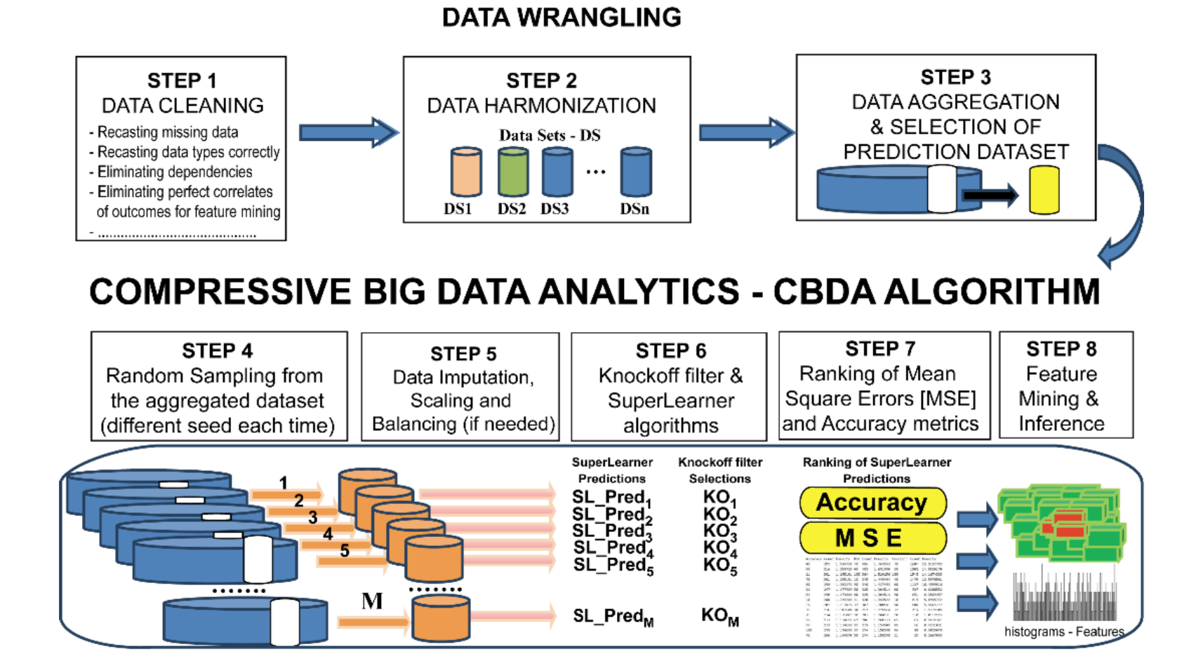
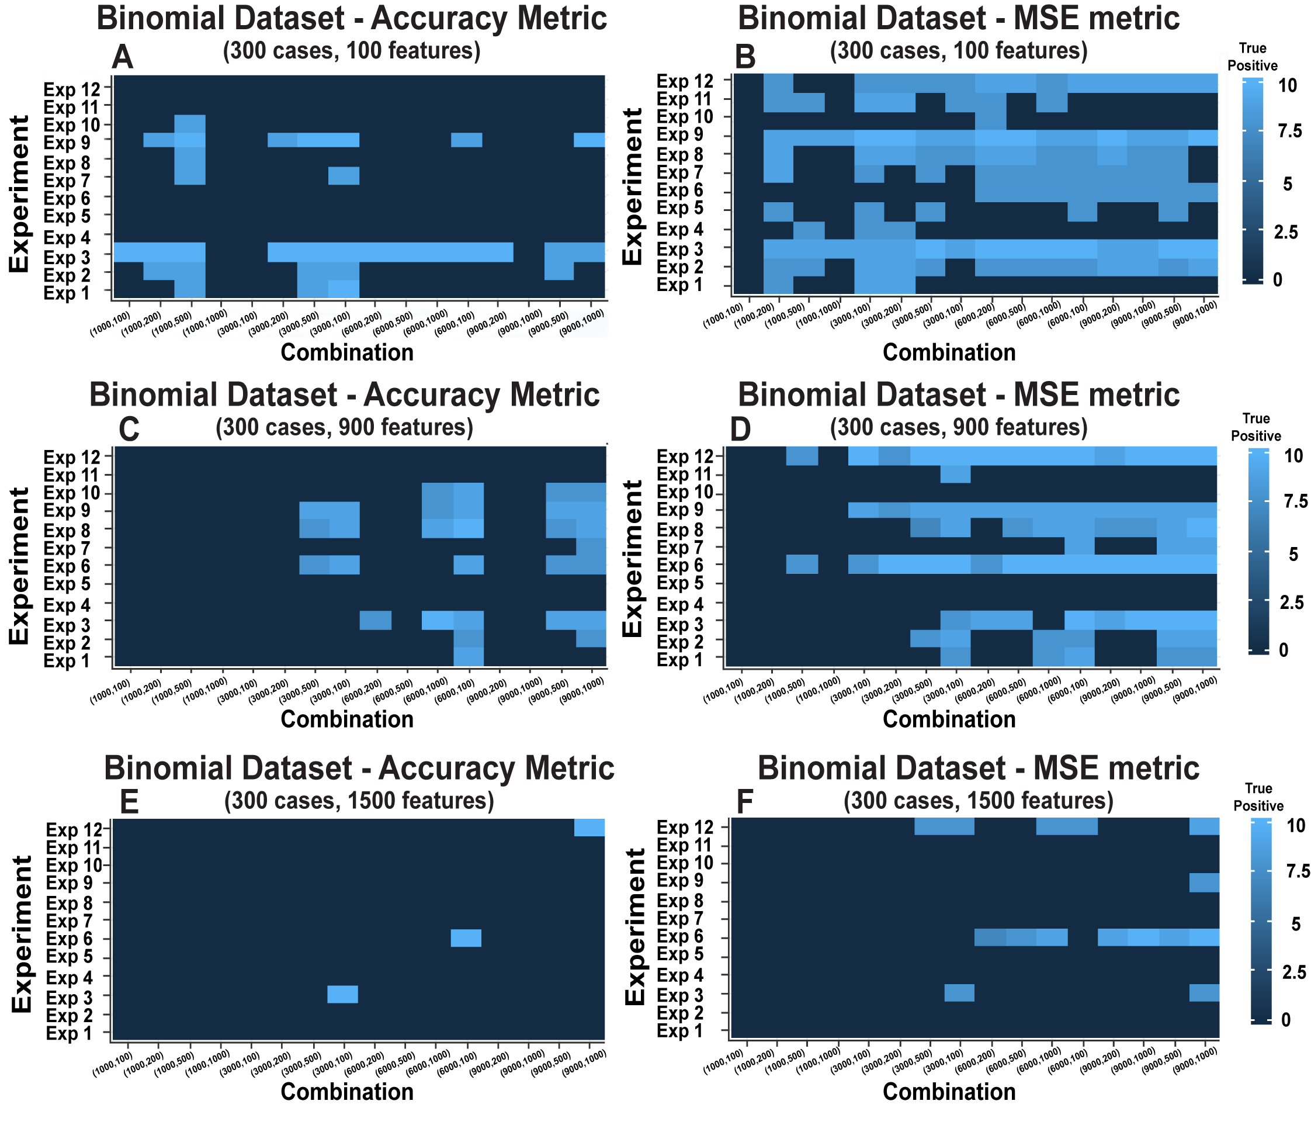
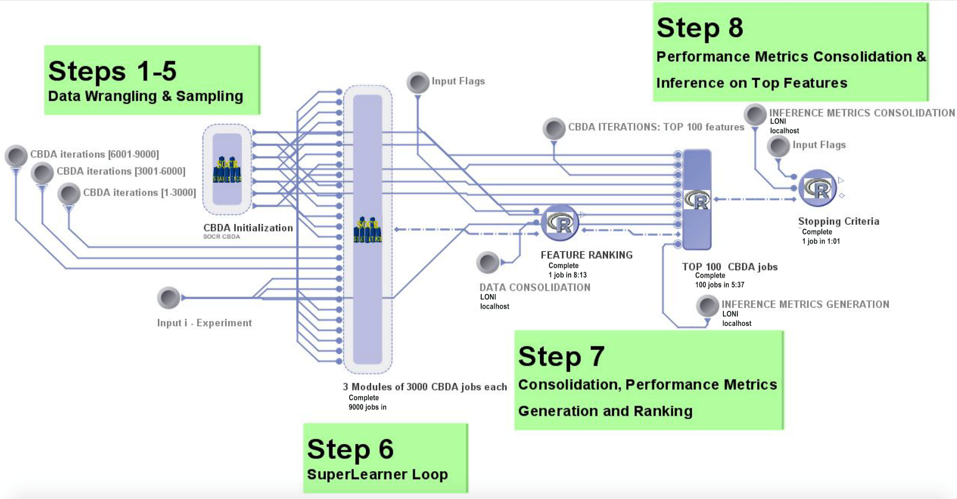
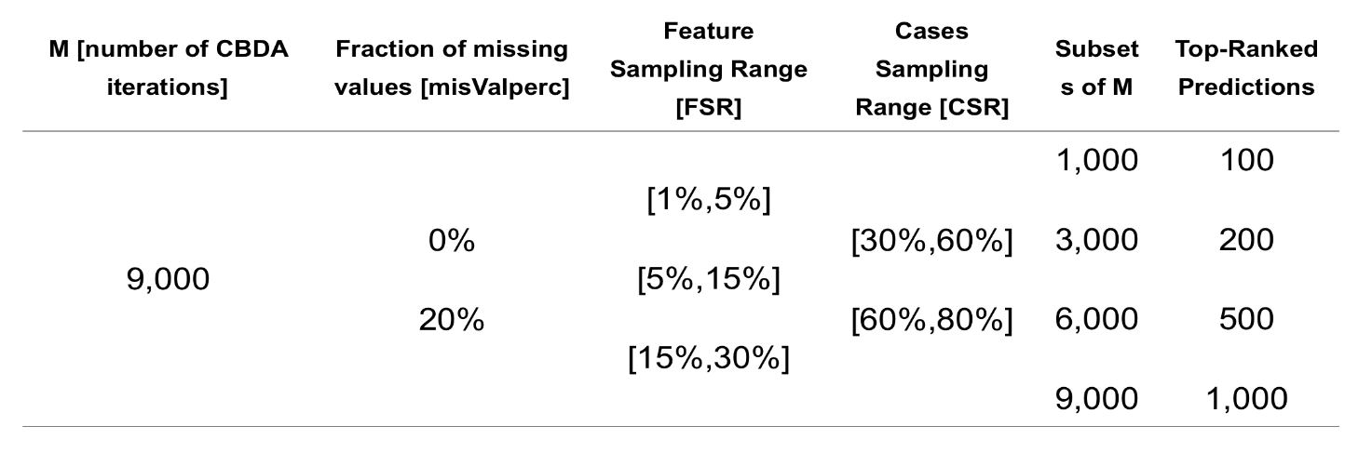
Compressive Big Data Analytics - CBDA
Applications to Biomedical and Health Studies
Simeone Marino, Jiachen Xu, Yi Zhao, Nina Zhou, Yiwang Zhou,
Yehu Chen, Yingsi Jian, Qiucheng Wu, Yichen Yang, and Ivo D. Dinov
Introduction
Framework & High Performance Computing
Biomed & Health Applications
Background
Big Healthcare Data Science deals with enormous amounts of complex, incongruent, and dynamic data (Big Data) from multiple sources and aims to develop algorithms, methods, tools, and services capable of ingesting such datasets and generating semi-automated decision support systems.
Major challenges in Big Healthcare Data analytics include:
Choice of reliable predictive model(s) to apply to the data
Specification and implementation of optimal algorithm(s)
Feasibility, scalability and convergence of the protocol on large datasets
Access to appropriate computational resources
We propose Compressive Big Data analytics (CBDA) to tackle most of these challenges. CBDA allows us to identify critical data features associated with specific traits, track multivariate relations and predict high-order trends in data. We also design a HPC pipeline to evaluate CBDA performance with precipitated time complexity in complex simulated and observed biomedical data. The CBDA flowchart is shown in Figure 1.
Models
CBDA is based on an ensemble predictor called SuperLearner (SL) that combines many different pre-defined algorithms into a single predictive model. The SuperLearner function takes the training set pair and returns the predicted values based on the validation data and the weights of each algorithm in final ensemble for further inference, and therefore greatly simplifies the choice of the predictive model(s) to apply to the data.
NOT SURE WE NEED THIS, UNLESS WE SHOW IT IN THE POSTER
In CBDA, we also employ False Discovery Rate (FDR) controlled variable selection by implementing the Knockoff (KO) Filter algorithm. KO takes the training set pair and returns a subset of features from selected as most important in explaining for further feature mining and inference.
Datasets
We validate the CBDA technique on three independent datasets. The first two, namely the Null and Binomial datasets, are synthetically generated as cases and features for the purpose of testing the protocol and assessing the CBDA performance. For all the Binomial datasets, only 10 features are used to generate the outcome variable. The third case-study represents a real biomedical dataset on Alzheimer’s disease using clinical and neuroimaging measures.
Software/Tools
The CBDA protocol is developed in the open source R environment (https://www.r-project.org/Licenses/).
The CBDA R package R1.0.0 is now available on CRAN (https://CRAN.R-project.org/package=CBDA ).
Production runs and validation of the CBDA protocol uses the open source workflow application LONI pipeline (http://pipeline.loni.usc.edu/).
CBDA Framework & HPC(LONI Pipeline)
Results
Null vs Binomial Datasets
Figure 4: Heatmaps of CDBA protocol performance for the binomial datasets across 12 different experiments summarized in Table 1
MAIN RESULT
Even with low undersampling rates, the CBDA protocol can identify most of the true features.
Figure 1: CBDA Framework
Figure 3: Feature mining results of the CBDA protocol applied to the Null and Binomial Datasets. The spikes on panels B, D and F represents the true features
Figure 1 describes the main steps of the CBDA protocol.
LONI Pipeline in Figure 2 enables us to utilize the algorithm on a way bigger data set with the following advantages:
High throughput
Scalable
Efficient
Fast Computational
MAIN RESULTS
- The MSE metric is more effective in increasing the CBDA performance.
- With an increased number of features, the CBDA has less optimal combinations that reach our minimal target level of true positives (i.e., 7 out of 10)
- Certain experiments are performing consistently better (which ones?)
Results on the Alzheimer Dataset
 | Reference
Prediction | AD | MCI | Normal
AD | 69 | 17 | 1
MCI | 12 | 243 | 8
Normal | 0 | 9 | 140
Overall Statistics
Accuracy | 0.9058 [ 95% CI = (0.8767, 0.93)]
No Information Rate | 0.5391
P-Value [Acc > NIR] | <2e-16
Kappa | 0.8426
McNemar's Test P-Value | 0.589
 | AD | MCI | Normal
Sensitivity | 0.8519 | 0.9033 | 0.9396
Specificity | 0.9569 | 0.913 | 0.9743
Positive Pred Value | 0.7931 | 0.924 | 0.9396
Negative Pred Value | 0.9709 | 0.8898 | 0.9743
Prevalence | 0.1623 | 0.5391 | 0.2986
Detection Rate | 0.1383 | 0.487 | 0.2806
Detection Prevalence | 0.1743 | 0.5271 | 0.2986
Balanced Accuracy | 0.9044 | 0.9082 | 0.9569
Figure 2: LONI Pipeline workflow
Datasets for Validation
Null Datasets
The outcome with is completely independent from the set of features X. Each column of with
Binomial Datasets
We select 10 features from X to build a linear additive model with
and Then outcome Y is generated by with
*n and p are number of cases and features respectively.
ADNI Case-Study
This dataset consists of three cohorts of patients (2,500 cases) with three diagnoses : EO-AD (Early Onset Alzheimer Disease, N1=406), Normal (N2=747) and EO-MCI (Early Onset Mild Cognitive Impairment, N3=1,347).
Table 2: Confusion Matrix and Statistics
POORLY WRITTEN – PLEASE EDIT CAREFULLY (check the manuscript)
CBDA protocol ranked the top 1,000 predictions out of the 9,000 learning samples and consistently returned across the 4 experiments the same top 10 features . We used these 10 features as input features for a final SuperLearner analysis on the validation set, obtaining a 95% confidence interval of [87.67%, 93%] for accuracy.
Experimental Design
Conclusions and Discussion (expand with slightly more details)
PLEASE explain in few words (bullet points) the meaning of some of the items in Table 2.
CSR:
FSR:
….
In a nutshell, the CBDA method takes a divide-and-conquer approach utilizing ideas from Compressive Sensing (CS) and Signal Processing (SP). Current results provide evidence of the effectiveness of CBDA to deal with complex and heterogeneous real data application.
Further studies will examine the theoretical CBDA properties as well as the performance of the CBDA technique on larger biomedical datasets.
-…..
SOCR is supported by:
University of Michigan School of Nursing,
NSF grants DUE 1416953, 0716055 and 1023115, and NIH grants P20 NR015331, U54 EB020406, P50 NS091856, P30 DK089503
Table 1: Experimental Design

